Slide 1
teaching with the SimGlobal system
STEM-UP NETWORK
john carter mcknight
brittni linn
24 March 2018

Slide 2
what is SimGlobal?
a live-action roleplaying system
an upper-division course: Simulating Global Crises
a means of showing students STEM skills at work in global humanitarianism

Slide 3
live action roleplay

Slide 6
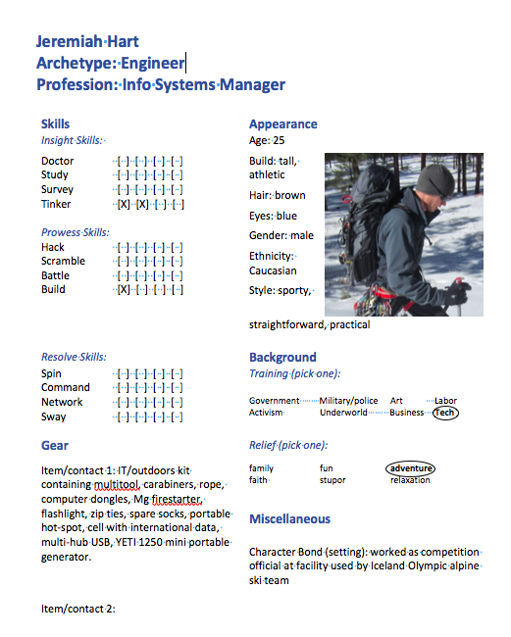

Slide 7
Game Master’s Guide

Slide 8
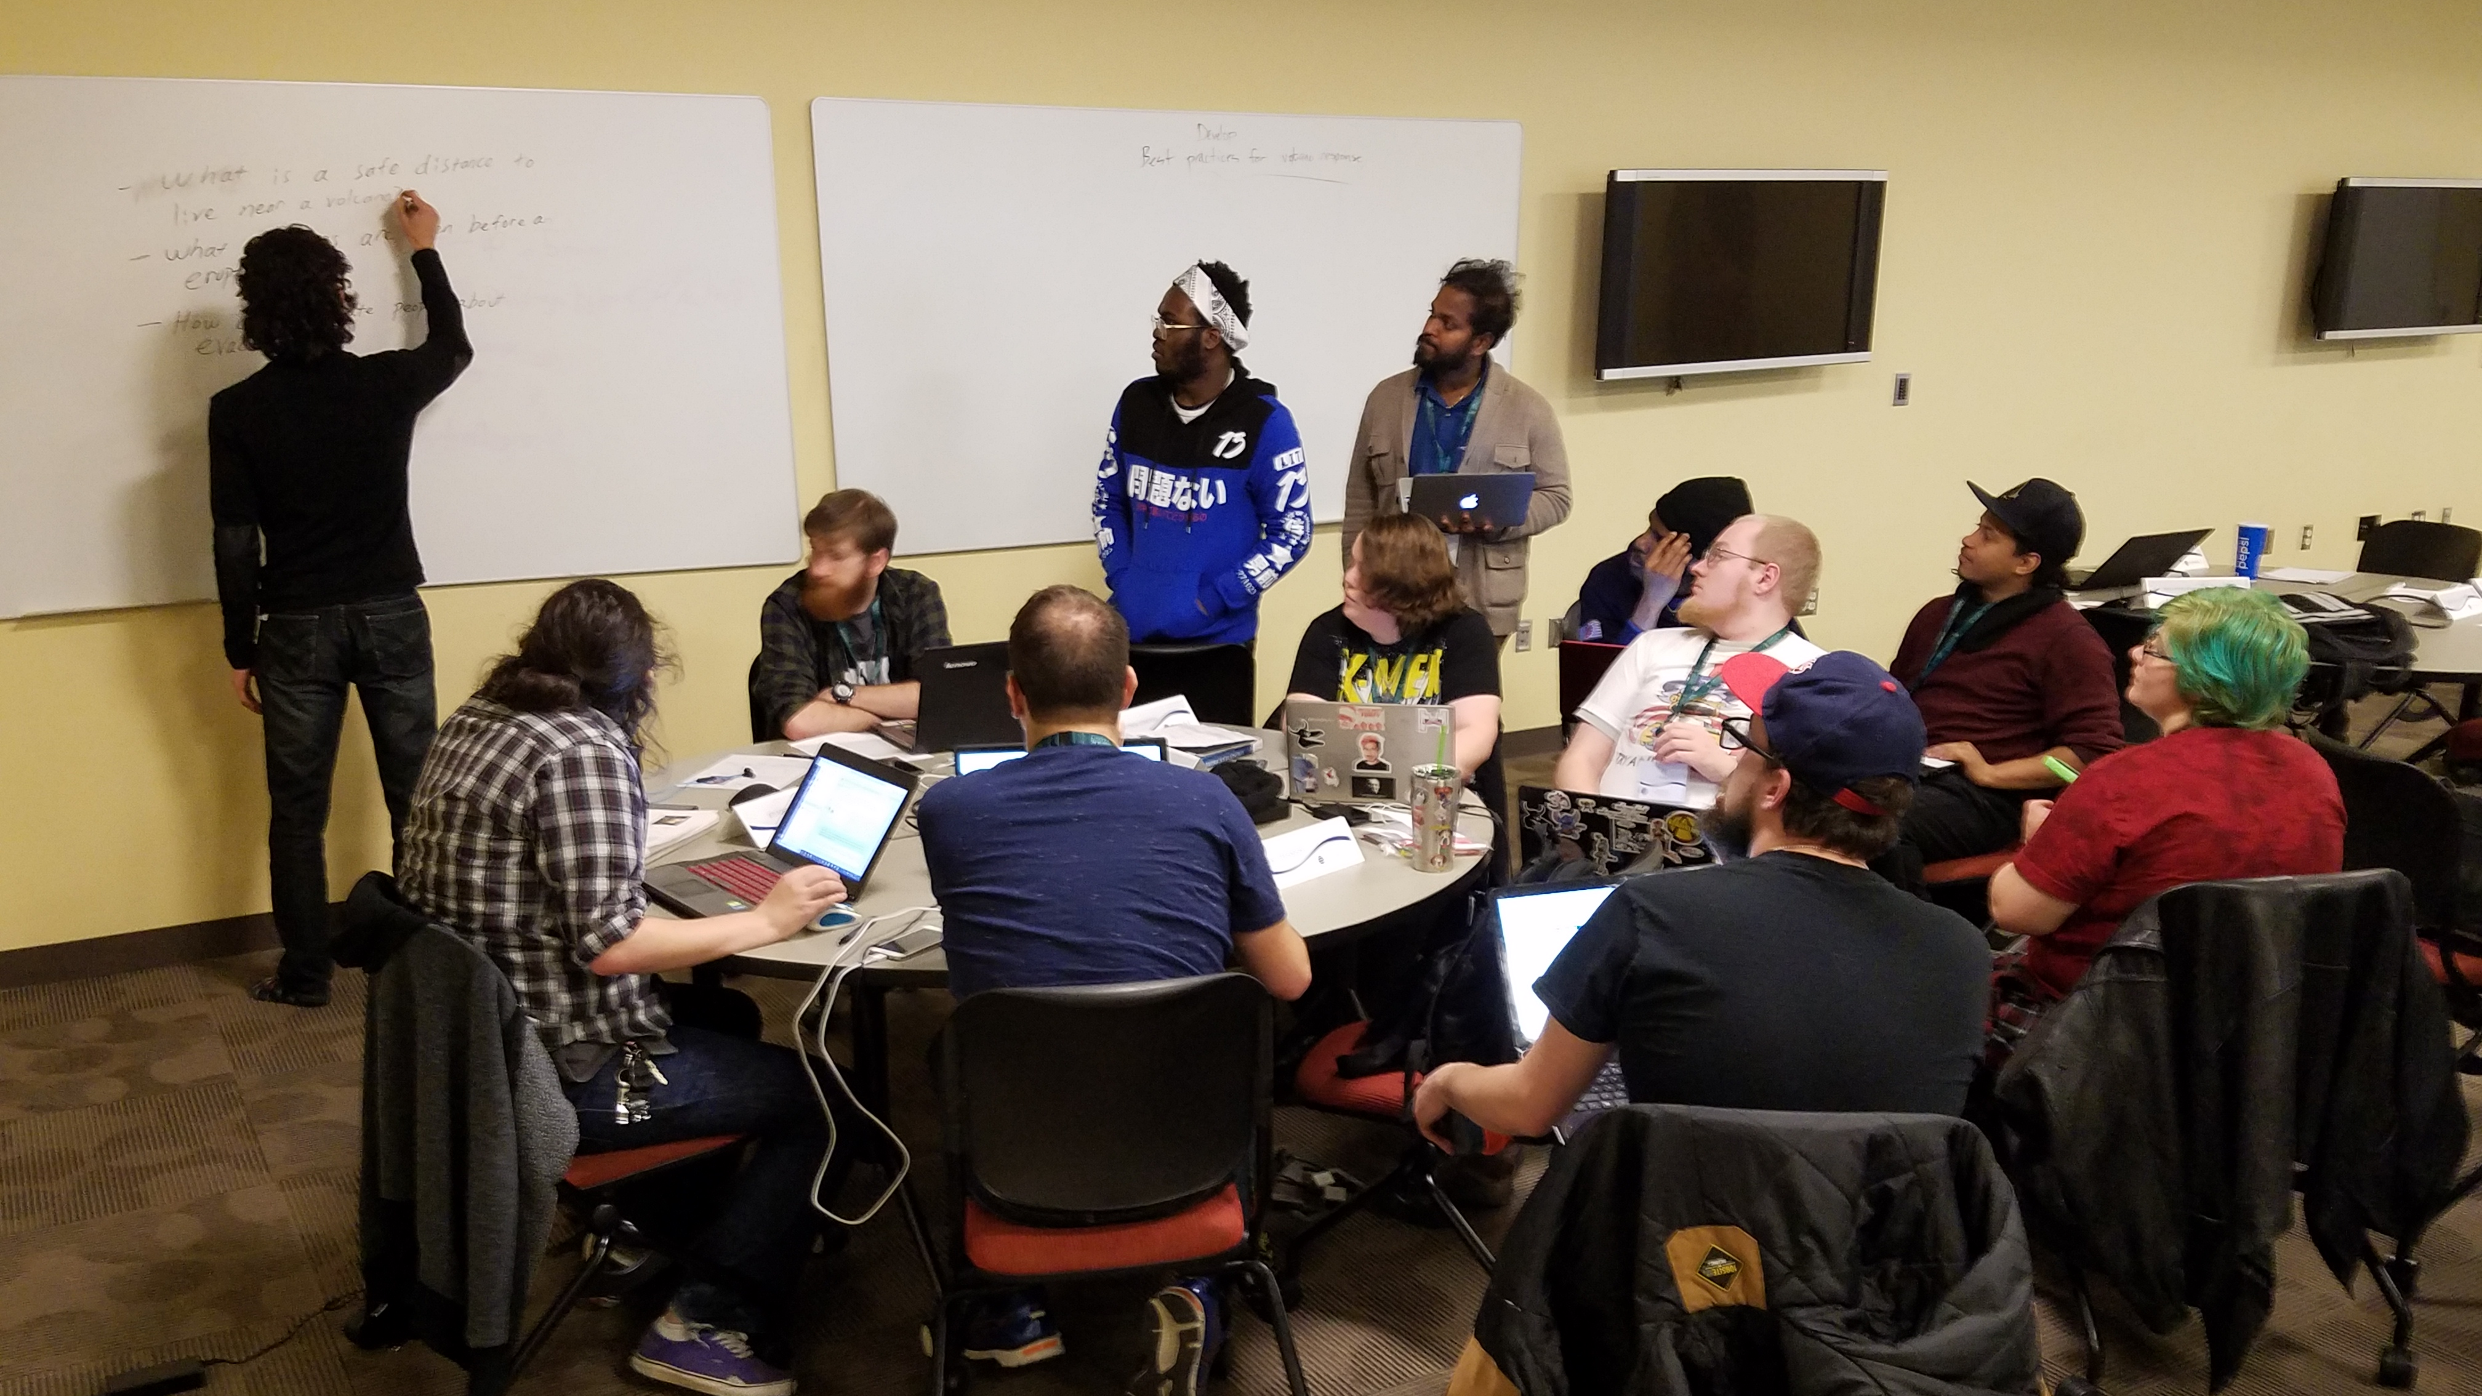

Slide 9
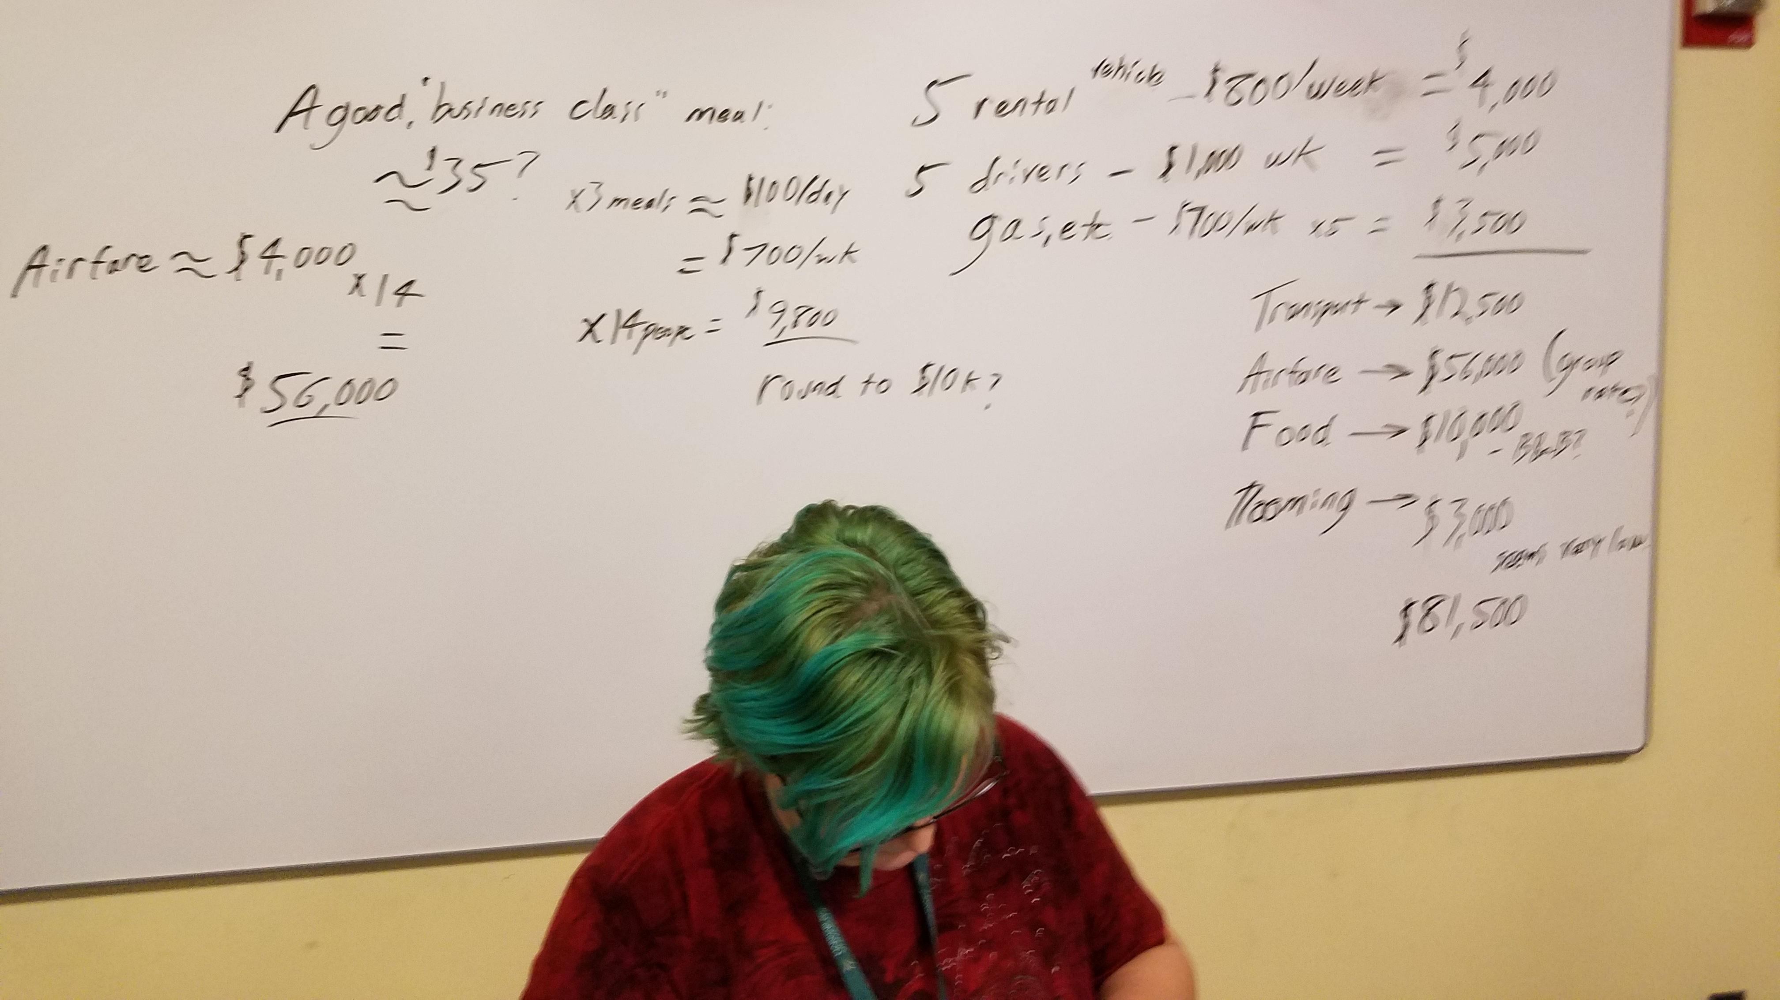

Slide 10
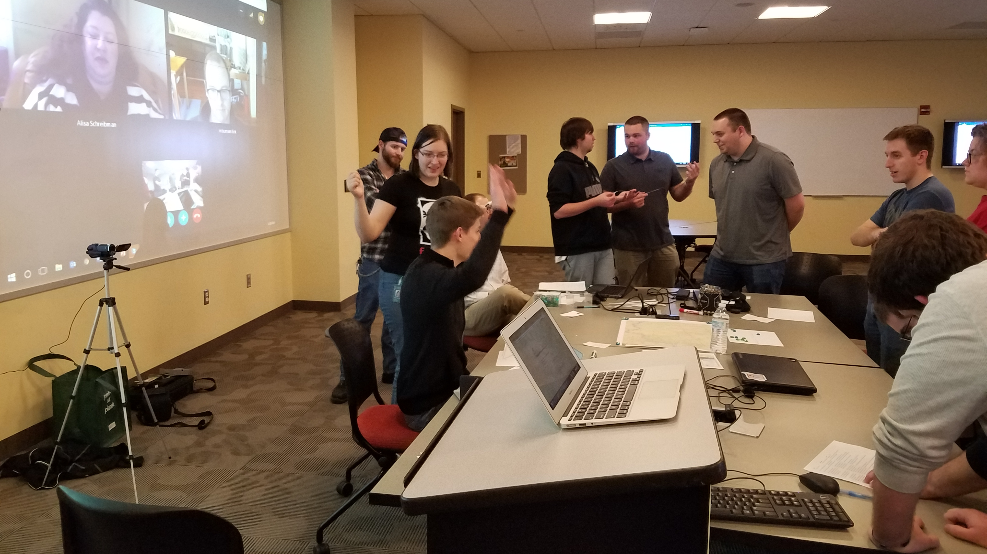

Slide 11
upper division course

Slide 12
This course is built on three pillars: Actualities, Alternatives, and Aspirations.
Actualities are current processes, laws, customs, scientific understandings, and technologies.
Alternatives are novel ways of solving social and material problems.
Aspirations are guiding ethical principles, goals, and visions for a better world.

Slide 13
global humanitarianism

Slide 15
In this course, students will develop scenario planning abilities and crisis response skills through an immersive, interdisciplinary, team-based experience.
In modeling events such as disease outbreaks, climate change, natural disasters, political unrest, and economic disruption, students will practice real-world techniques applicable to many contemporary situations in business, government, and NGOs.
Students will propose responses to emerging global issues developed through refining and applying research strategies, critical and ethical reasoning, and communication skills.

Slide 16
a day in the life

Slide 17
agenda
5 minute culture: farming in Iceland
OODA reminder
IC recap: Saturday Week 1
RP: Sunday Week 2 onward
5 minute science: Katla system
5 minute science: Jökulhlaups
assignments for Thursday

Slide 18
5 minute culture: farming in Iceland
42:30 – 49:30

Slide 19
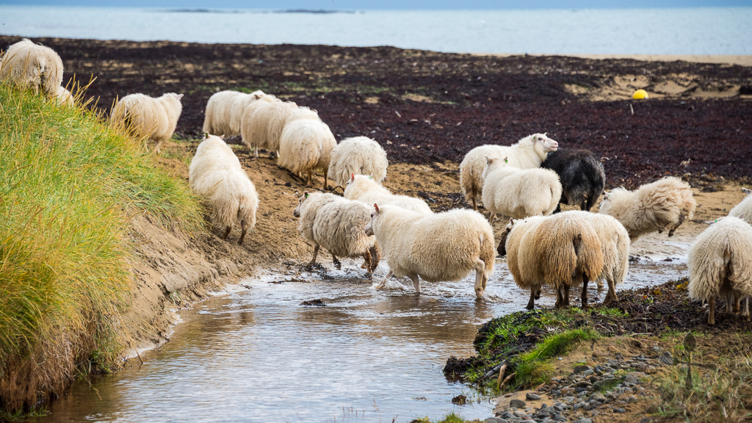

Slide 20
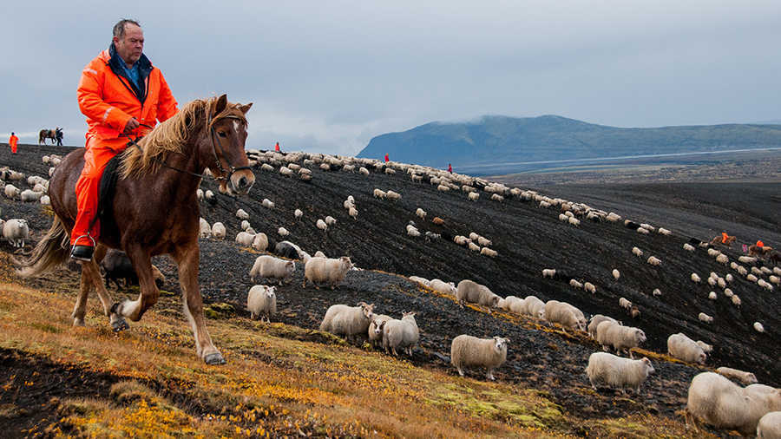

Slide 21
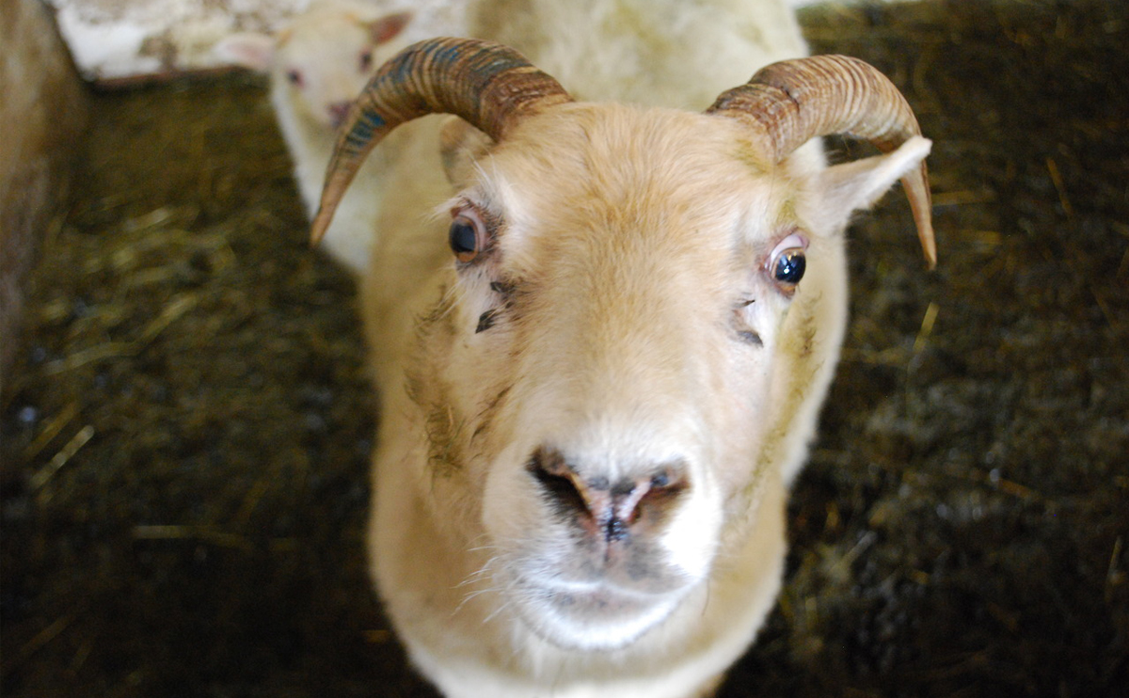

Slide 22
the OODA loop – dummies version

Slide 23
OODA in SimGlobal rp
OBSERVE: Get up to speed on what’s happening in the world
Ask questions
Research
Do what you need to get the info you want
ORIENT: Think about what needs to be done
Cooperate with your team
Plan ahead
DECIDE: choose what your character will try
Look at your specialties and those of your teammates
ACT

Slide 24
OODA in SimGlobal rp, cont.
Tell the story of what your character does (act)
Take turns
Talk to the GM about what your character does and how they apply their skills
Listen while others describe their actions- they may surprise you
The GM will resolve the action and deliver outcomes
During lulls, you or your character should work on your long-term project

Slide 25
recap
Saturday 27 January

Slide 26
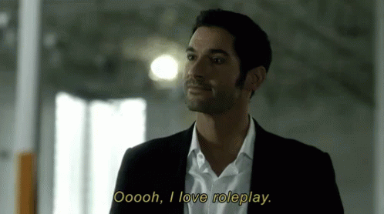
IC scenario

Slide 27
Sunday, January 28

Slide 28
Reykjavik Team
Notes:
Use evocative languages/all five senses to bring them from RL to RP.

Slide 29
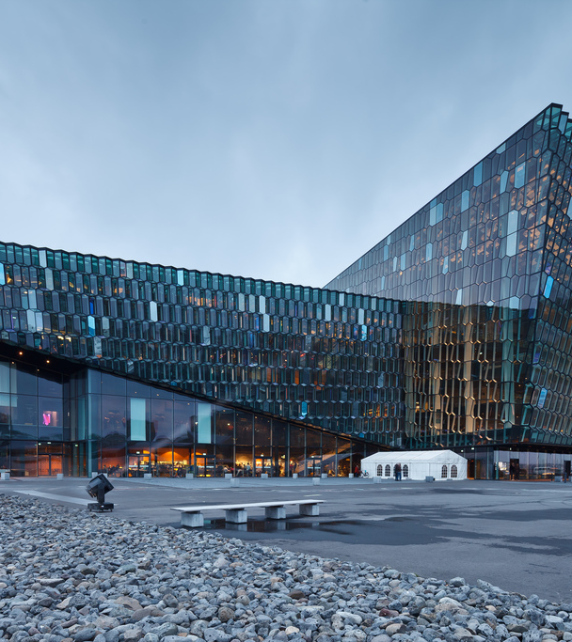
https://en.harpa.is/harpa/conference-and-concert-halls/

Slide 30
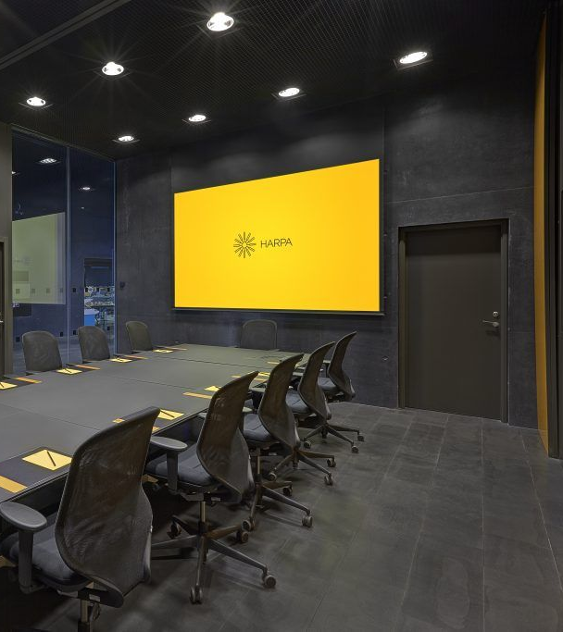

Slide 31
5 minute science: Katla system

Slide 32
Katla Volcanic System
HIstory of the Katla Volcano
Katla is a large volcano in southern Iceland. It is very active; twenty eruptions have been documented between 930 and 1918, at intervals of 13–95 years. It has not erupted violently for 100 years, although there may have been small eruptions that did not break the ice cover, including ones in 1955, 1999, and 2011. It is currently one of the most likely of Iceland’s volcanoes to erupt in a large event in the near future.
Last large/violent eruption‎: ‎October to November 1918
Elevation‎: ‎1,512 m (4,961 ft)

Slide 33
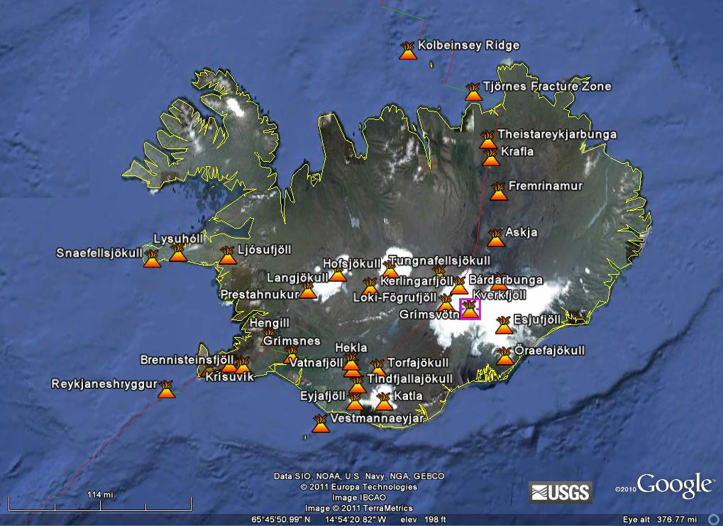
Volcanoes of Iceland
Katla System

Slide 34
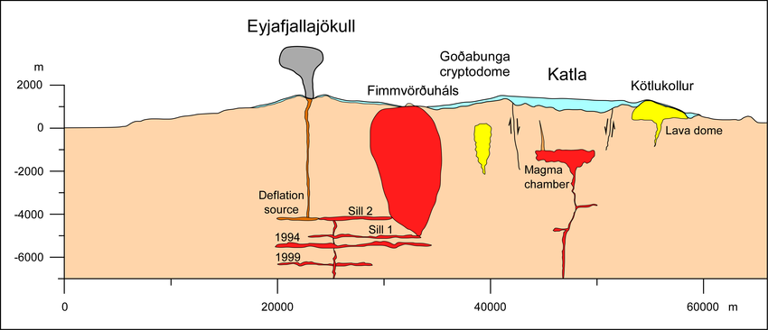
Cross Sectional View of the Katla Volcanic System

Slide 35
Sequence of Events in a Volcanic Eruption
Pre-Eruption
Increase in Seismic Activity
Vertical crustal deformation as seen in GPS data as skin stretches
Potential for jökulhlaup development - glacial outflow due to geothermal heating of the volcanic ice cap
During Eruption
Lava flow
Potential Lahar Development
Tephra/Ash Cloud Formation

Slide 36
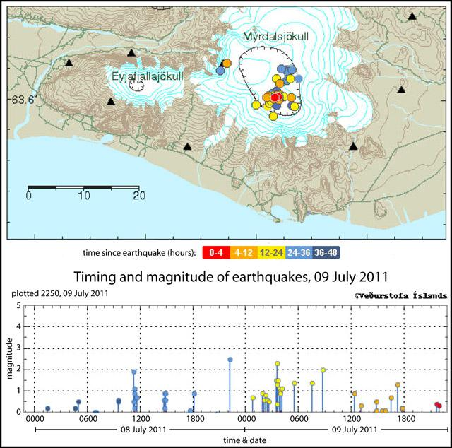
Earthquake swarms during a small
Eruption at Katla, July 9, 2011

Slide 37
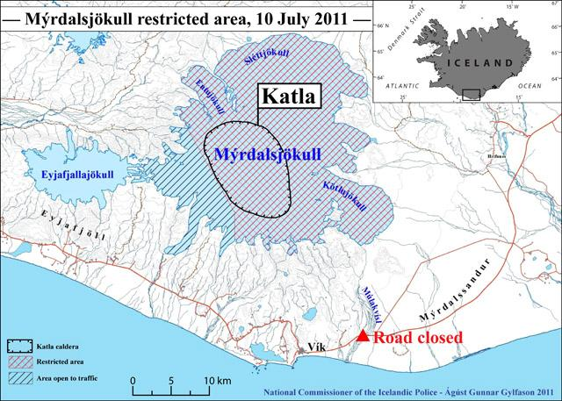
Myrdalsjokull Ice Cap potential jökulhlaup
Katla
Eyjafjallajokull Volcanoes
Restricted
Area Map during the July 2011 Katla Eruption

Slide 38
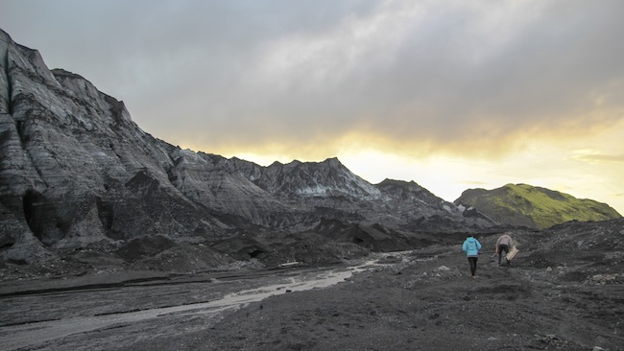
field team

Slide 39
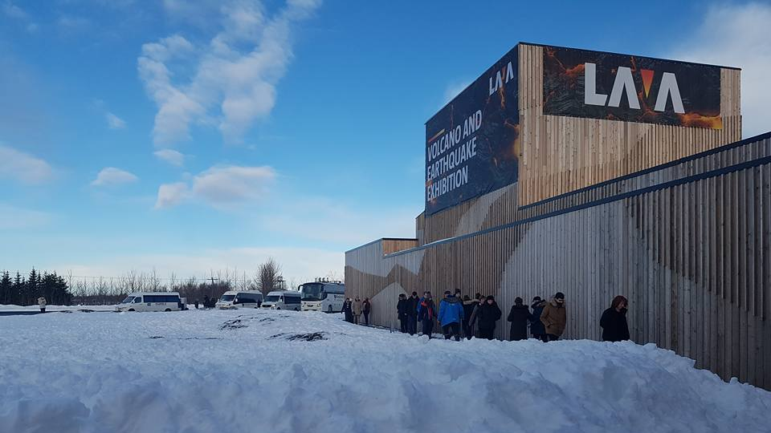

Slide 40
5 minute science: Jökulhlaups

Slide 41
Science Short : What is a Jokulhlaup?
A jökulhlaup (Icelandic pronunciation: ​[ˈjœːkʏl̥øip]) (literally "glacial run") is a type of glacial outburst flood.
Icelandic term that has been adopted in glaciological terminology in many languages. It originally referred to the well-known subglacial outburst floods from Vatnajökull, Iceland
Describes any large and abrupt release of water from a subglacial or proglacial lake/reservoir.
Triggered by geothermal heating and occasionally by a volcanic subglacial eruption.

Slide 42
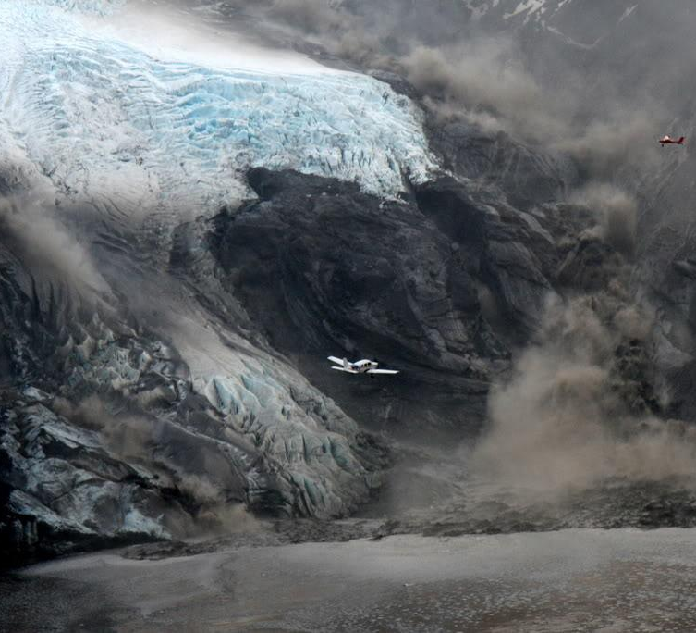
Jokulhlaup
Daring pilots approaching the melting glacier near Eyjafjallajökull eruption, 2010. Torrents of meltwater can be seen in the background from the melting glacier.

Slide 43
Eyjafjallajökull glacial flood (jökulhlaup) April 14th 2010
https://www.youtube.com/watch?v=fJII-u-41Lg

Slide 44
assignments for thursday
draft outline of consultancy report

