Slide 1
Peer review of writing to improve scientific communication
Susannah Gal, PhD
Professor of Biology
Associate Dean of Research and Outreach
Penn State Harrisburg

Slide 2
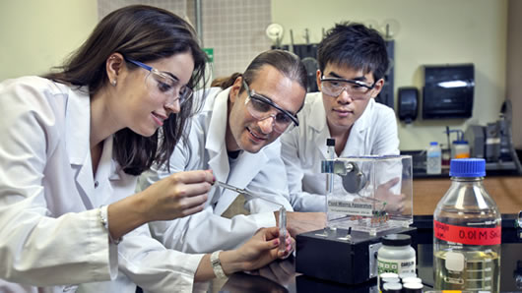
Challenge: how to teach scientific writing
Some students chose science to avoid writing
Need writing to convey thoughts and understanding
Writing lab reports for an upper level biology class

Slide 3
My frustration
How to have students write clearly and completely in a good scientific style
Had lots of laboratory reports all with similar errors
Gave examples of research articles even an excellent laboratory report from another student
Still had issues

Slide 4
Help came from a writing workshop
Taught by a creative writing instructor, Pamela Gay
Talked about using peer review to help
Challenge: I was not communicating well my expectations
How to do that clearly?

Slide 5
Created a peer review guide
With the help of Pamela Gay (Creative Writing faculty)
What errors was I seeing
What things did I want them to express (or not)
How to articulate that

Slide 6
My examples of types of questions on peer review sheet
Scientific questions
1. Does the Results section:
--begin with an introductory sentence or two that explains the purpose of the laboratory?
If there is such a sentence, does it accurately reflect your understanding of the purpose of the laboratory experiments? If not, explain.
An example of such a sentence form is: “In order to determine …, we did ….”
---briefly mention data from a provided table or gel? Are the results from the gel complete? Are they too extensive? Explain.

Slide 7
My examples of types of questions on peer review sheet
Editorial corrections
1. Circle on the page any spelling errors, even if you are unsure of the correct spelling.
2. Underline any sentences that seem incomplete to you.
A complete sentence: The gel showed the DNA was completely digested by EcoRI.
An incomplete sentence: The DNA in the gel completely digested by EcoRI.
3. Check for subject-verb agreement, errors occur when subject and verb are separated.
Example 1: The results of the DNA gel is not conclusive.
Example 2: The DNA digested with different restriction enzymes are not visible on the gel.

Slide 8
Activity
Think of a writing error/challenge for your students
Share that with your neighbor
Brainstorm for 2 minutes how you might write that in a peer review guide

Slide 9
Implementation
Provided overview of the value of peer review for them
Gave them peer review sheets ahead of time
Required drafts of papers/reports one week before deadline
Used class time to allow them to do peer review
Required submission of draft and review with final report- comments from writer
Graded review- 5, 2 or 0 pts

Slide 10
Other ways I’ve used peer review
Non-lab Cancer Biology class for writing papers
Fellowship writing class for personal and research essays
Sample section below:
How well did the work or activity of the person match those mentioned by the organization or in the statement of the fellowship?
Point out specific places where the writer described their career goals. Is it clear what role the proposed program plays in the writer’s career goals?
Writing and organization:
Is the information logically presented? Explain why or why not with examples.
Are there topic and transition sentences? (those that provide flow to the writing)

Slide 11
Value added for peer review
Gets student to avoid writing the whole thing the night before (;-)
Helps student reviewers to see errors in their own work or good ways to express things
Reduced my time needed to read the papers
Does reduce lecture or lab time

Slide 12
Questions/comments?
Susannah Gal
sjg5538@psu.edu
Thanks!

